Slide 1

Institute of Technology
of Cambodia
Object Oriented Programming
Lecturer: Mr. Chan Sophal
Mr. Tal Tongsreng

Slide 2
Group3 members
HAK KIMHONG
MAO KIMLANG
KEO VONMONYROTH
CHEA MAKARA
MEN CHANCHHORPORN

Slide 3
Table of content
Java Access Modifiers
Java Non Access Modifiers
The Static Modifier
The Final Modifier

Slide 4
Java Access Modifiers
What is Java Access Modifiers
Java access modifiers is control the access level in Java ( object in class)
There are 4 types
Public
Private
Protected
Default

Slide 5
Public Access Modifier
The code is accessible for all classes
Private Access Modifiers
The code is only accessible within the declared class.

Slide 6

Default Access Modifiers
The code is only accessible in the same package.
This is used when you don’t specify a modifier.
Protected Access Modifiers
The code is accessible in the same package and subclasses.

Slide 7
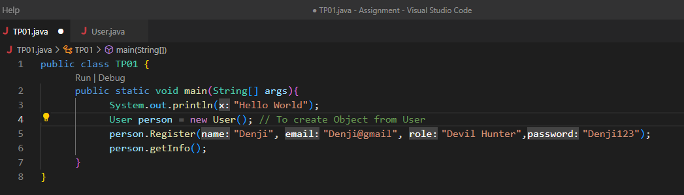
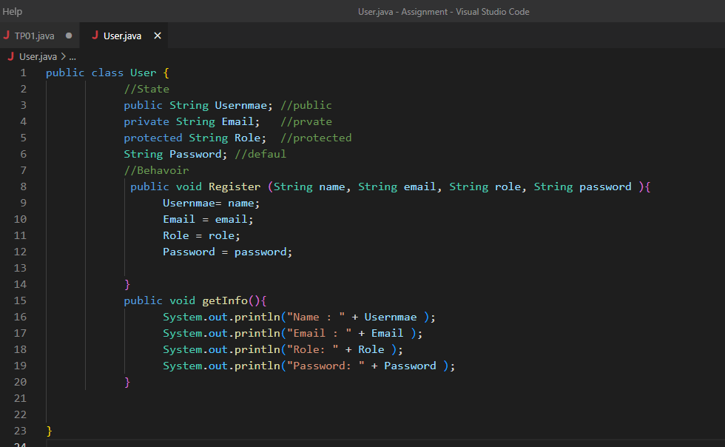

Slide 8
2. Java Non Access Modifiers
What is Java Non Access Modifiers
Java provides a number of non-access modifiers to achieve many other functionalities.
The static modifier for creating class methods and variables.
The final modifier for finalizing the implementations of classes, methods, and variables.
The abstract modifier for creating abstract classes and methods.
The synchronized and volatile modifiers, which are used for threads.

Slide 9

3. The Static Modifier
Static variable: the value is the same for every instance of the class and can bé accessible without creating in instance of class.
Static methods : can be called using the same way and cannot access instance variables or methods.

Slide 10
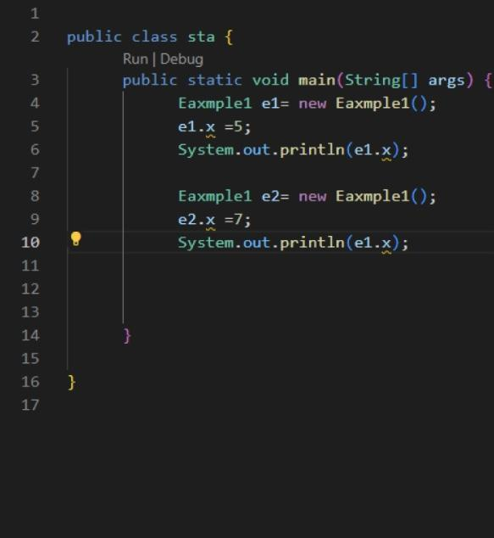
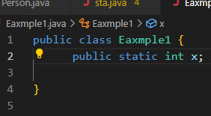

Slide 11
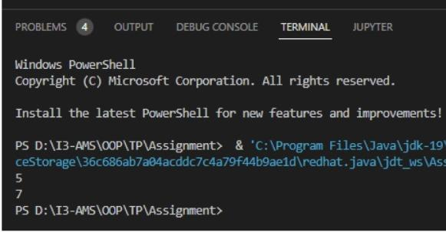

Slide 12
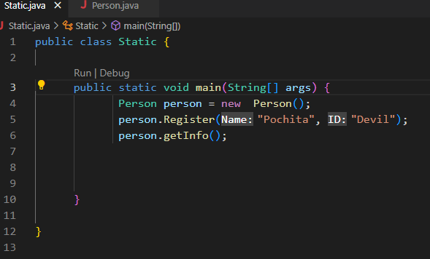
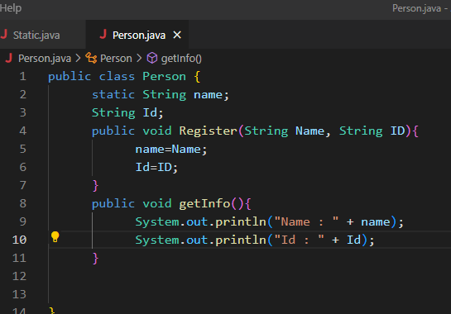

Slide 13
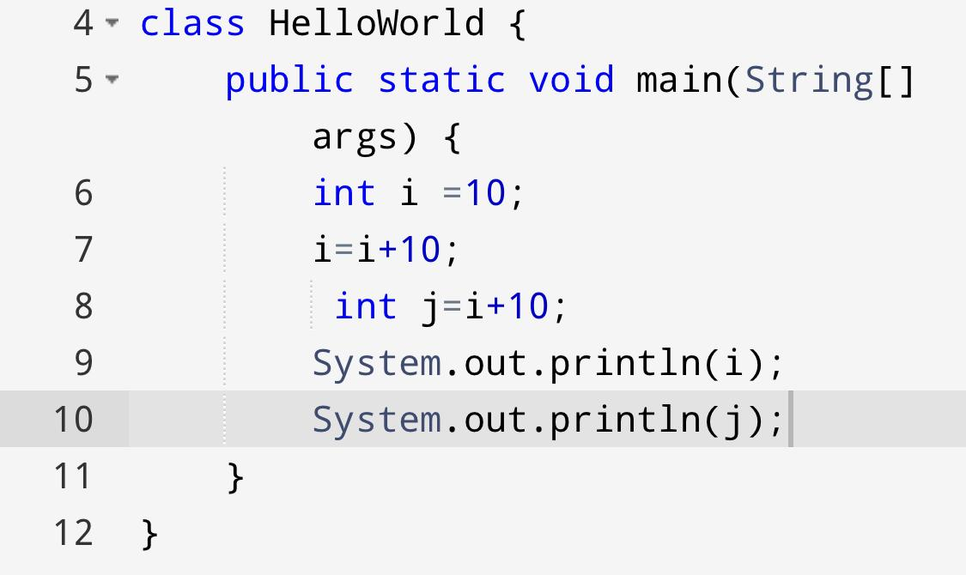
4. The Final Modifier
Final Modifier means one of the variable or method is assigned a value or equation it can never be changed
There are 2 type of Final modifier:
Final variable
Final method

Slide 14


Slide 15
Thanks!
Any questions?

